Slide 1




MAJOR PROJECT
KID PROXIMITY DETECTION PROJECT: ENHANCING CHILD SAFETY
A DYNAMIC APPROACH TO SCREEN VISIBILITY FOR CHILD SAFETY
R180996 - JHANSYSREENIVAS MANCHURI

Slide 2

Overview
Introduction
Background and Literature Review
Problem Statement
Project Overview
Research Context
Objectives & Goals
Technologies Used
CNN Algorithm
Data Collection
Data Preprocessing
Data Training and Data Testing
Results
Challenges and Limitations
Future Enhancements
Conclusion
References

Slide 3

Introduction
Introduction:
Children's interactions with digital spaces have become increasingly pervasive, raising substantial concerns about their safety in this dynamic environment. The exponential rise in digital device usage among children has underscored the need for innovative solutions to safeguard their well-being.
Importance of Kid Proximity Detection:
In this context, Kid Proximity Detection emerges as a crucial technology. It addresses the risks associated with unmonitored screen interactions, providing a dynamic and responsive approach to enhance child safety.
Overview of Project's Objectives and Significance:
The project focuses on developing and implementing a Kid Proximity Detection System that dynamically adjusts screen visibility based on a child's proximity.

Slide 4


Background and Literature Review
In today's world, children are fully immersed in the digital realm, using smartphones and tablets as integral parts of their daily lives.The prevalence of digital devices among children is undeniable, with these tools serving educational and recreational purposes. Yet, this widespread digital interaction brings forth concerns, such as prolonged screen time and exposure to inappropriate content, raising questions about their well-being. Addressing these modern challenges requires innovative solutions that can adapt to the dynamic nature of children's digital experiences. Traditional methods might not keep up with the fast-paced changes in the digital landscape.
Key Points:
Children extensively use digital devices for various purposes.
Concerns include excessive screen time and exposure to inappropriate content.
Meeting these challenges demands innovative and adaptable solutions for a rapidly evolving digital environment.

Slide 5
PROBLEM STATEMENT
Challenges:
Identifying the challenges associated with unmonitored screen interactions is crucial for understanding the potential risks that children face in the digital age.
Prolonged Screen Time:
Unrestricted screen time may lead to adverse effects on children's physical and mental well-being.
Exposure to Inappropriate Content:
Lack of monitoring increases the risk of children encountering age-inappropriate content, posing potential harm.
Impact on Digital Environments:
Unmonitored interactions can contribute to the deterioration of the overall quality and safety of digital environments for children.

Slide 6
PROJECT OVERVIEW
Kid Proximity Detection System:
Introducing an innovative solution, the Kid Proximity Detection System, designed to enhance child safety during digital interactions.
Dynamic Screen Visibility Approach:
The system employs a dynamic approach to adjust screen visibility based on a child's proximity in real time.
How the System Works:
When a child is in close proximity, the screen dynamically blurs, providing an immediate visual cue to ensure safety.
As the child moves away, the screen seamlessly returns to normal, creating a responsive and secure digital environment.
Importance of Real-time Adaptability:
Real-time adaptability is crucial for swift and effective responses to ensure continuous child safety during digital engagements.

Slide 7
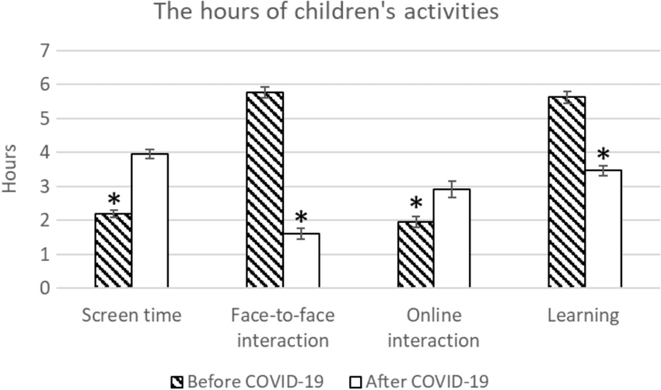
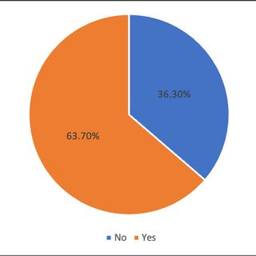
RESEARCH CONTEXT
Impact of Unmonitored Digital Interactions:
This can lead to various negative impacts on children, including exposure to inappropriate content, cyberbullying, privacy concerns, physical health issues, mental health impact.
Prevalence of Child Screen Interaction:
Negative Impact of the Unmonitored Digital Interactions : No Yes

Slide 8


Objectives & Goals
Reliable Proximity Detection
Easy Integration Everywhere
Develop a system using technology to alert parents when their child is near potential dangers, ensuring constant monitoring for enhanced safety.
Create a user-friendly tool that effortlessly fits into homes, schools, and public spaces, making child safety practical and accessible for all.

Slide 9




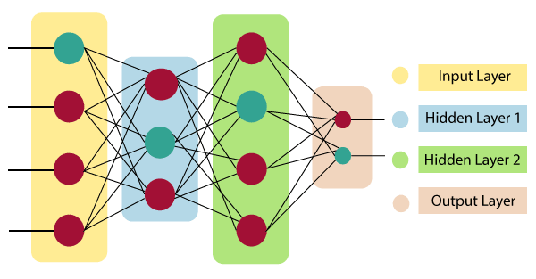
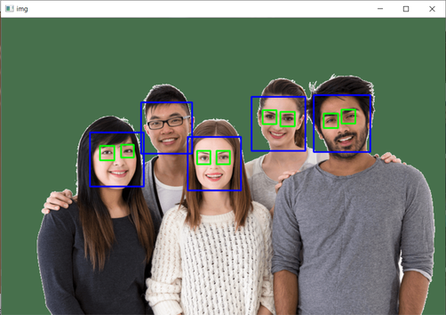
Technologies Used
Machine Learning:
TensorFlow and Keras are employed for developing, training, and evaluating machine learning models.
Computer Vision ToolBox:
OpenCV serves as a comprehensive computer vision library, contributing to image processing tasks such as face detection in the scripts .
Neural Network Architecture:
MobileNetV2, a convolutional neural network design optimized for mobile and embedded applications, functions as the underlying architecture in the script train_model.py for extracting features.
Haar cascades:
Haar Cascades are utilized for object detection, specifically faces, in both the scripts. Haar cascades act as classifiers identifying objects in images or video frames.

Slide 10
CNN Algorithm
Types Of ML
Algorithm
Why This?
CNN Algorithm:
The main machine learning algorithm used in this project is called MobileNetV2. MobileNetV2 is a type of convolutional neural network designed for tasks like image classification. In simpler terms, it's a smart system that learns to recognize whether an image contains a child or an adult, helping in Kid Proximity Detection.
MobileNetV2 was chosen because it's a smart and efficient technology. It works well for recognizing whether an image has a child or an adult, making it ideal for Kid Proximity Detection. Its efficiency and ability to adapt to specific tasks make it a good fit for this project.
There are a Total of 3 Types of Machine Learning Algorithms. They are:
Supervised Learning
Unsupervised Learning
Reinforcement Learning
The Algorithm that's been chosen comes under Supervised Learning.

Slide 11
Data Collection
Gather a diverse set of images representing children and adults from various sources, ensuring a balanced distribution between classes for unbiased model training.
Manually annotate each collected image with the corresponding class label (child or adult) to create a labeled dataset, forming the foundation for supervised learning.
Prioritize privacy and ethical considerations during data collection, especially when obtaining images from individuals. Comply with privacy laws, obtain necessary consents, and implement security measures to safeguard collected data.

Slide 12
Data Preprocessing
Data Preprocessing :
Normalization:
Pixel values are rescaled to the range [0, 1]. Normalization ensures that all pixel values fall within a consistent and standardized range, facilitating effective model training.
Augmentation:
Data augmentation techniques are introduced to diversify the dataset. These techniques include: Rotation, Shifting, Shearing, Zooming, Horizontal Flipping
Neural Network Architecture:
CNN - MobileNetV2:
MobileNetV2 is a convolutional neural network (CNN) architecture renowned for its efficiency and suitability for real-time applications. It serves as the base model for image classification.

Slide 13
Data Training & Data Testing
Data Training:
Training Dataset:
Utilizes preprocessed data from 'archive/train' for neural network training.
Model Training:
Trains CNN - MobileNetV2 with 'adam' optimizer, 'binary_crossentropy' loss, and accuracy metrics.
Implements early stopping to prevent overfitting during training.
Data Testing:
Testing Dataset:
Reserves preprocessed data from 'archive/test' for independent model evaluation.
Model Testing:
Assesses model performance on the testing dataset.
Provides test accuracy, confusion matrix, and classification report for comprehensive evaluation.

Slide 14

Results
Accuracy Achieved
Real-world Performance
Highlight the accuracy during training and testing phases.
Showcase improvements and the model's ability to generalize.
Summarize the model's performance in real-time scenarios.
Briefly discuss any observed efficiencies or areas for future improvement.

Slide 15


Challenges & Limitations
Implementation Challenges:
Acknowledging potential challenges encountered during the Kid Proximity Detection System implementation.
Examples include technical complexities, sensor accuracy, and real-world applicability.
System Limitations:
Addressing limitations inherent in the Kid Proximity Detection System.
Discussing aspects such as false positives/negatives, environmental factors affecting sensor accuracy, and potential challenges in diverse scenarios.

Slide 16
Future Enhancements
Our team
Using IOT to apply the model to Webcams
To Develop a Mobile App
Our future focus is directed towards crafting an intuitive mobile app, empowering parents and caregivers with seamless access to real-time insights and alerts from our Kid Proximity Detection system, fostering a safer environment for children.
In the future, we plan to use IoT technology to connect our Kid Proximity Detection system, making it smarter and more connected. This will give parents and caregivers timely alerts and insights, creating a safer and more interconnected system for child safety.

Slide 17
CONCLUSION
In Conclusion: Advancing Child Safety in the Digital Realm
In wrapping up our journey through Kid Proximity Detection, we've unveiled a groundbreaking approach to bolstering child safety in the ever-expanding digital landscape. Our project stands not just as a technological feat but as a testament to our commitment to safeguarding the well-being of the youngest members of our digital society.
Key Takeaways:
Innovation in Action:
Our endeavor represents a stride forward in utilizing cutting-edge technology for real-time proximity monitoring, ensuring a safer online experience for children.
Practical Impact:
Beyond the code and algorithms, our project carries real-world significance. It translates to tangible advancements in child safety, addressing challenges and setting new standards.

Slide 18



REFERENCES
Text Books :
Murphy, K. P. (2012). "Machine Learning: A Probabilistic Perspective."
Video lectures and tutorials on platforms like YouTube.

Slide 19

THANK YOU
For watching this presentation
7382197227 - S Nandini
6303412088 - I S Rizwan Raja
9392763867 - Jhansysreenivas Manchuri

